Slide 1




Indexed Files - Introduction
An indexed file is a file that allows access to data records by way of a key field. The files is said to be “indexed” by this key.
Indexed files are sometimes referred to as keyed files.
A record in an indexed file contains at least one key field. There must be at least one key field that contains a unique value known as Primary Key.
Primary key functions like a serial number. With this key you can find and access the remainder of the record.
FEU – EAST ASIA COLLEGE
Information Technology Department

Slide 2
Indexed Files - Introduction
Indexed files is not limited to a single key field.
Indexed files may have Alternate key fields. Unlike the primary key, alternate key may or may not be unique.
When you define the key structure of the file in COBOL program, you must specify whether any alternate key fields contain duplicates.

Slide 3
Uses of Indexed Files
To validate user input. With an indexed file, you can determine whether the record is in the file with a single read.
Ideal for storing any information that you can identify by some key field.

Slide 4
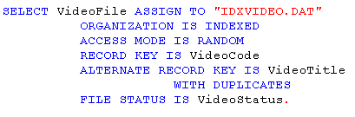
Defining the Indexed Files
The Select statement for Indexed Files
This is where you define the key data for the indexed file.

Slide 5
Defining the Indexed Files
Organization Indexed – specifies that this file is an indexed file.
Access Sequential, Random, or Dynamic – specifies how the records in the file are to be retrieved and/or updated.
Record key – Specifies the primary key. Only one primary key is allowed.
Alternate record key – specifies the alternate key field for the file. A single file may have multiple alternate key statements.
With duplicates – if coded, the associated Alternate record key may contain duplicates.

Slide 6
Random Access
Random access is similar to deciding which page of a book to open to, opening exactly on that page, reading it, and then closing the book. You may not read the next page or the preceding page without first closing and reopening the book, but only the page you specified.

Slide 7
Writing Records (Random Access)
When you use Random Access and have the file Open I-O, you may write new records to the file.
If a duplicate primary key is encountered, a File Status of 22 is returned. Your new record does not replace the existing record.
Any file status that begins with 2, such as 22, is an Invalid Key condition. You may code the Invalid Key clause with the write.

Slide 8
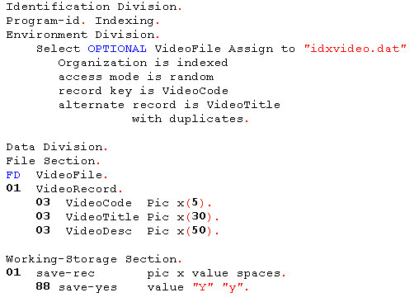

Slide 9
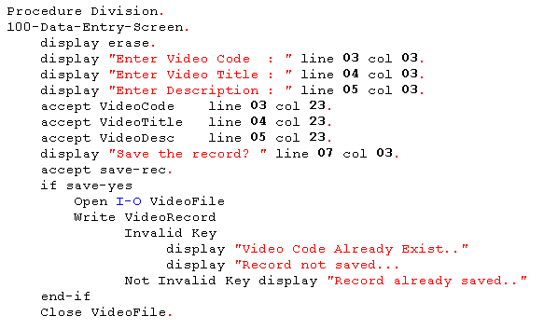

Slide 10
Reading Records (Random Access)
When reading from the file using Random Access, you must place a value in the KEY field of the file being read. A simple MOVE statement will do.
MOVE “L1234” TO VideoCode.
The next Read statement for the file returns the record identified by VideoCode L1234.
READ VideoFile.

Slide 11
Reading Records (Random Access)
If the file contains no record matching the Key specified, a File Status 23 is returned, which is an invalid Key condition. You may code the Invalid Key clause after the READ to handle these conditions.
Read VideoFile
Invalid Key Display “No Record Found”
Not Invalid Key Perform Disp-Record
end-read

Slide 12
Reading Records (Random Access)
Unless otherwise specified, the Read statement assumes that you are reading via the Primary Key field.
When you Read via the Alternate Key, the specific key field must be coded in the Read statement.
You must remember to Move the data value required to identify the desired record into the Alternate Key field before the Read.

Slide 13
Reading Records (Random Access)
Move “DTE-STCK” to VideoCode.
Move “Dora the Explorer” to VideoTitle.
Read VideoFile Key VideoTitle
Invalid Key Display “No Record Found!”
Not Invalid Key Perform Process-Record
End-read

Slide 14
Reading Records (Random Access)
Some files may be defined with an Alternate Key that allows duplicates. If a random read is attempted against such a key and a record is identified that has an identical alternate key to another record in the file, a File Status 02 is returned. The record returned is the oldest in the file.
The At End clause is not valid for use on a Read statement when the file is Open for Random Access. The record being read will exist or not.

Slide 15
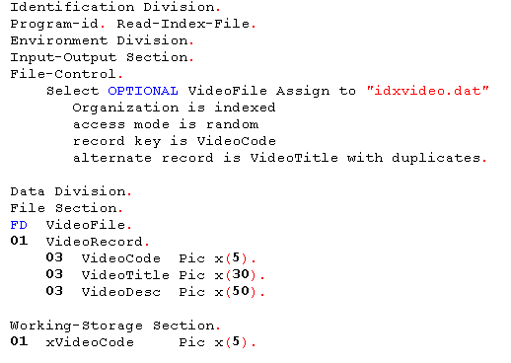

Slide 16
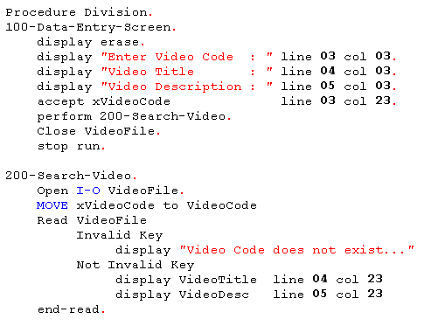

Slide 17
Updating Records (Random Access)
In random access, the Rewrite statement is less restrictive. It does not have to be preceded by a successful READ statement.
The primary determines the placement of the record in the file.
When you execute the Rewrite statement, if the Primary Key does not exist, the file status is set to 23 – record not found – and an invalid key condition occurs.

Slide 18
Updating Records (Random Access)
If you Rewrite a record and cause a duplicate Alternate Key condition, a File Status of 22 is returned and an Invalid Key condition occurs.

Slide 19
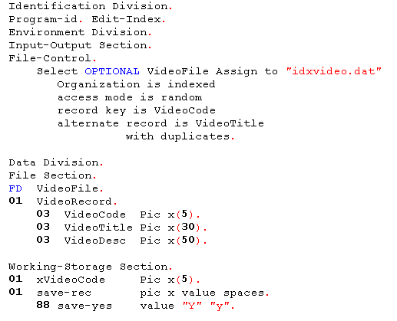

Slide 20
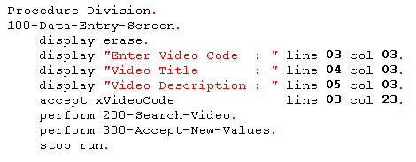

Slide 21
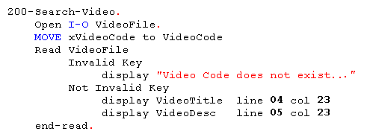

Slide 22
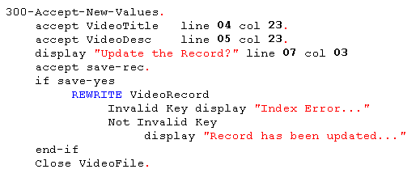

Slide 23
Updating Records (Random Access)
The Delete statement is valid only when the file is Open I-O.
The primary key of the file is the determining factor in deleting a record.
If random access, delete statement is less restrictive. The record being deleted need not have been previously read. Simply fill in the primary key information in the record description for the file and issue the DELETE statement.

Slide 24
Updating Records (Random Access)
If the record does not exist, a file status of 23 is returned and an Invalid Key condition exists. You may code the Invalid Key clause on a DELETE statement.
The delete statement applies only to the record identified by the Primary Key of the file. Deleting a record through alternate key does not work.

Slide 25
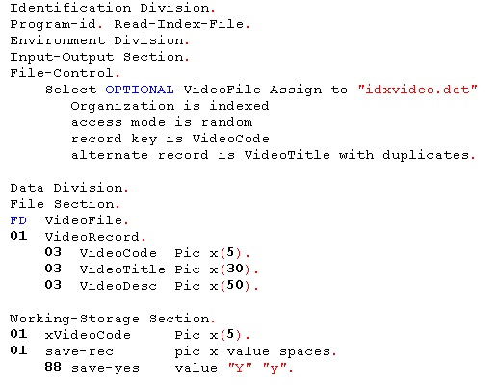

Slide 26
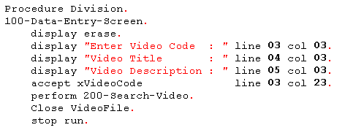

Slide 27
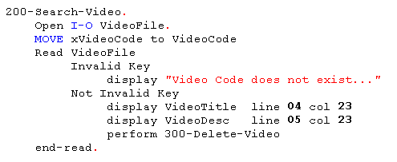

Slide 28
